Slide 1
INSTRUCTIONS
Use Font size 22 to 28 and Font Style Times New Roman (body)
Do not change the Template: Heading / Title of the slides
Do not change font style or colours
Do not copy paste paragraphs: use only Bullet Points
Maximum slide Limit is 20 only
As per the number of supervisor allotted adopt slide-2 or slide-3
Please display the required meaningful Content or images or tables
Change the footer accordingly using insert tab then click on header & footer tab and edit it
Save the PPT with Register No, Dept and Review no, example: 23xxxxxxxxx_CSE

Slide 2

Title: Secure Web Based Online Quiz System
Student Name: Raavi Bhavitha
Student ID: 2520030489
Cluster: 3
Section: 9
Under the Guidance
of
Supervisor Name: Mrs.Surekha
Assistant Professor
Department of CSE

Slide 3
OUTLINE
Abstract
Existing System
Proposed System
System Architecture
Project Modules
Objectives
Co’s Attainments - FWD
Co1
Co2 …….. 5. Co5
Co’s Attainments - DSA
Co1
Co2 …….. 5. Co5
Screen Shots for FWD & DSA
Conclusion
Geo-Tagged Photos

Slide 4
Abstract
Secure Web-Based Online Quiz System is a web application for conducting online exams
Students can register, log in, and attempt quizzes
Developed using HTML, CSS, JavaScript, Java, and MySQL
Covers all five Course Outcomes (CO1–CO5) of FWD and DSA subjects
Provides secure authentication and controlled access
Reduces manual effort in exam management
Supports efficient and reliable online assessments

Slide 5
Existing System
Traditional exams conducted using paper-based methods
Manual evaluation requires significant time and effort
High chances of human error during result calculation
Difficult to manage large numbers of students
No automatic feedback or instant result generation
Question papers may get leaked or misplaced
Limited flexibility for conducting remote exams

Slide 6
Proposed System
Web-based application for conducting quizzes online
Students can access exams through secure login
Admin can create, update, and delete quiz questions
Automatic result calculation after quiz submission
Timer-based examination system
Secure database storage for student records
Easy access from any device with internet

Slide 7
System Architecture
Presentation Layer (Frontend)
HTML for page structure
CSS for design and responsiveness
JavaScript for interactive elements
Application Layer (Backend)
Java for processing quiz logic
Authentication and result processing
Data Layer (Database)
MySQL database for storing
Student data
Questions
Quiz results

Slide 8
Project Modules
Module 1 – User Authentication
Student registration and login
Module 2 – Admin Management
Create and manage quiz questions
Module 3 – Quiz Module
Students attempt quizzes with timer
Module 4 – Result Evaluation
Automatic score calculation
Module 5 – Database Management
Stores user details, questions, and results

Slide 9
Objectives
Design and implement a fully functional Secure Web-Based Online Quiz System using HTML, CSS, JavaScript, and Java
Demonstrate CO1–CO5 outcomes of FWD: semantic HTML, CSS styling, JavaScript programming, DOM manipulation, and event handling
Apply DSA concepts such as Arrays, Stack, and HashMap for storing quiz questions, answers, and user data
Build a multi-user system with secure student registration and login authentication
Implement an online quiz module with timer-based examinations and automatic answer submission
Provide automatic result evaluation and score calculation after quiz completion
Ensure secure data storage using database management for questions, users, and results

Slide 10
Co’s Attainments - FWD
CO1 – HTML Structure
Created web pages using semantic HTML tags
2. CO2 – CSS Styling
Designed responsive user interface
3. CO3 – JavaScript Programming
Implemented quiz logic and timer
4. CO4 – DOM Manipulation
Dynamic question display and form handling
5. CO5 – Web Storage & APIs
Interaction between frontend and backend

Slide 11
Co’s Attainments - DSA
CO1 – Arrays / Lists
Store quiz questions and answers
2. CO2 – Stack Concept
Used for navigation between questions
3. CO3 – HashMap / Key-Value Storage
Store user responses and results
4. CO4 – Searching Algorithms
Retrieve questions from database
5. CO5 – Complexity Analysis
Efficient handling of quiz data

Slide 12
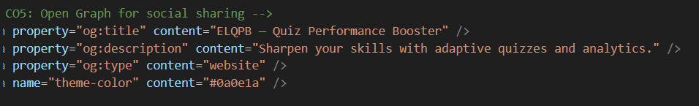
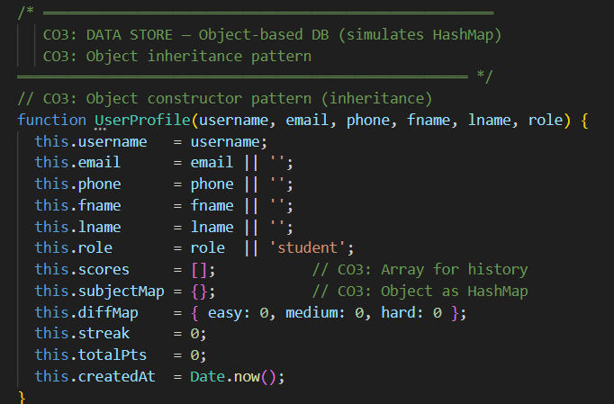
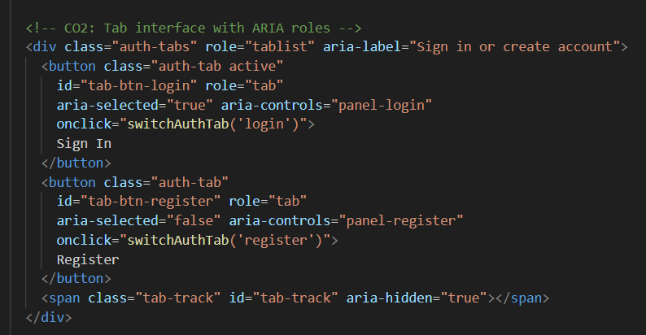
Screenshots for FWD & DSA

Slide 13
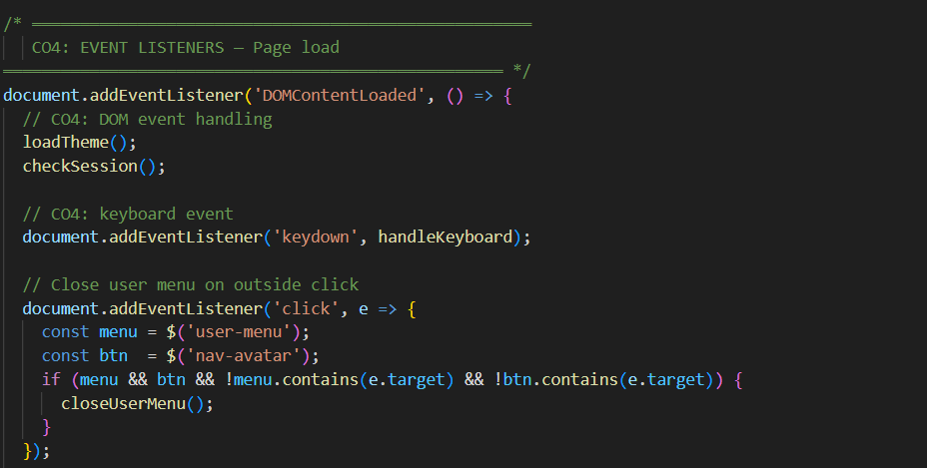
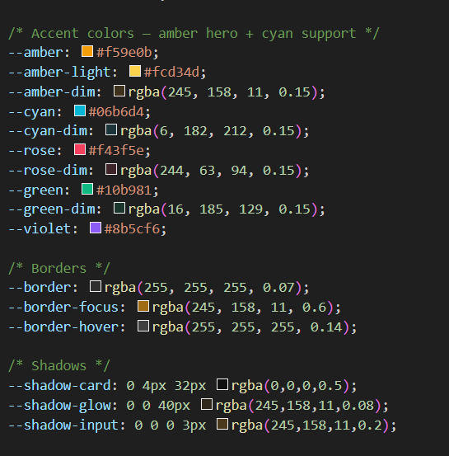
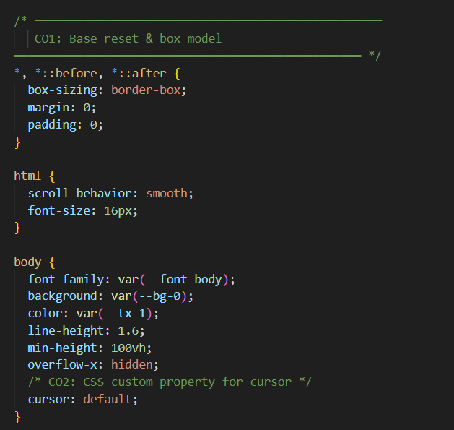
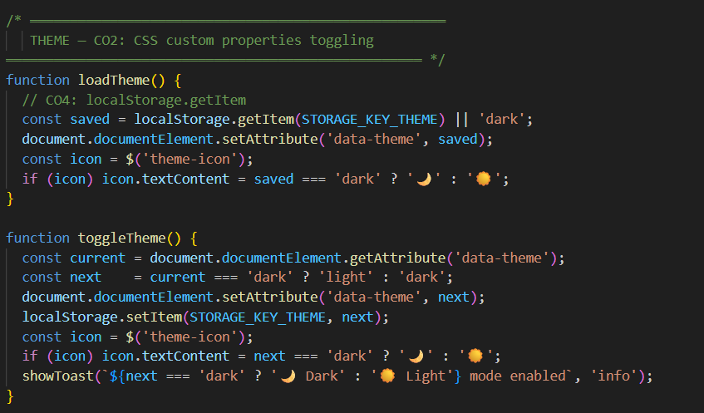
Screenshots for FWD & DSA

Slide 14
Conclusion
Successfully developed a Secure Web-Based Online Quiz System for conducting online examinations
Demonstrated all five CO outcomes for FWD: HTML, CSS, JavaScript, DOM, and Advanced Web Features
Applied DSA concepts such as Arrays, Stack, and HashMap for storing quiz questions, answers, and results
Built a secure multi-user system with student registration, login authentication, and database storage
Implemented an online quiz interface with timer-based exams and automatic result evaluation
Provided a user-friendly dashboard for students and administrators to manage quizzes and view results
Future Scope: AI-based quiz analysis, cloud database integration, and mobile application support
The project demonstrates the practical implementation of web development and data structure concepts in an online examination system.

Slide 15
THANK YOU

